Slide 1
PIZZA SALES PRESENTATION

Slide 2

CONTENTS
PROJECT OVERVIEW
PROJECT’S STEPS
DATA ANALYSIS DOMAINS
DATA DESCRIPTION
SQL ANALYSIS (QUERIES)
VISUALIZATION (POWER BI)
KEY INSIGHTS
REFERENCES

Slide 3
PROJECT OVERVIEW
OBJECTIVE: The primary objective of this project is to analyze pizza sales data to uncover insights and trends that can help improve business decisions and strategies. By leveraging SQL for data extraction and transformation, and Power BI for data visualization, we aim to provide a comprehensive view of sales performance, customer behavior, and operational efficiency.
TOOLS: For the project, Microsoft Excel, MySQL, and Power BI applications are used.
APPROCH: Employ data analysis, SQL Analysis and Power BI visualization of the data for better understanding.
DATASET: Make use of an extensive dataset that records pertinent attributes.
METHODOLOGY: Investigate different SQL queries to get accurate results and to visualize trends and patterns more clearly.
OUTCOME: Gain practical SQL & Power BI Visualization skills through hands-on experience in Pizza Sales Analysis.

Slide 4
PROJECT’S STEPS
Data Extraction: Extract the necessary dataset from KAGGLE . Load the dataset in MySQL . Use SQL queries to
get a overview of the dataset.
Data Cleaning: Address any missing, duplicate, data type conversion or inconsistent data. This includes writing
SQL scripts to clean the data.
Data Transformation: Transform the raw data into a format suitable for analysis. This includes normalizing data,
creating new calculated fields.
SQL Queries: Multiple SQL Query for better understanding of data and then take the data for visualizations.
Connect to Data Sources: In Power BI, connect to the SQL database and import the prepared table.
Data Loading: Load the data into Power BI, ensuring that it is refreshed regularly if the data is dynamic.
Measure Creation: Create DAX measures to calculate key performance indicators (KPIs) and other metrics required for the analysis.
Design Dashboards: Create interactive dashboards in Power BI. Include visualizations such as charts, graphs, and maps that effectively communicate the data.
Customize Visuals: Customize the visuals to align with the company’s branding and make them easy to interpret.
Interpret Data: Analyze the visualizations to draw meaningful insights
Generate Recommendations: Based on the insights, generate actionable recommendations for the business.

Slide 5
DATA ANALYSIS DOMAINS
SALES ANALYSIS:- Pizza sales analysis using SQL and Power BI is a robust approach for gaining insights into sales performance and customer behavior. SQL is utilized to query the sales database, extracting relevant data such as Unit Price, Quantity and pizza specifics. This data is then cleaned and aggregated to identify trends, patterns, and anomalies in pizza sales, such as peak sales times, Percentage sales by size & Category. Once the data is prepared, Power BI is employed for visualization, enabling the creation of dynamic dashboards and interactive reports. This data is then processed to calculate key performance indicators (KPIs) such as Total Revenue, Average Order value, Total Pizza Sold, Total Orders and Average Pizza per order. The combination of SQL for data extraction and Power BI for visualization provides a comprehensive solution for effective pizza sales analysis.
BEST/WORST SELLERS:- Analyzing the best and worst pizza sellers using SQL and Power BI involves a systematic approach to uncovering performance metrics and identifying top-performing and underperforming sellers. SQL is first employed to query the sales database, retrieving data on individual seller transactions, sales volumes, and Total Revenue.. Using Power BI, these KPIs are visualized through interactive dashboards and detailed reports, highlighting the best and worst performers. Visualizations such as Stacked bar charts enable stakeholders to quickly grasp which sellers excel in terms of revenue and customer satisfaction and which ones lag behind. This analysis helps businesses to recognize successful strategies employed by top sellers, provide targeted support and training to underperformers, and ultimately improve overall sales performance and customer experience.

Slide 6
DATA DESCRIPTION
“pizza_sales”
NAME & DESCRIPTION OF THE COLUMNS:-
pizza_id - A unique identifier assigned to each distinct pizza variant available for ordering.
Order_id - A unique identifier for each order made, which links to multiple pizzas.
Pizza_name_id - An identifier linking to a specific name of the pizza.
Quantity - The number of units of a specific pizza variant ordered within an order.
Order_date - The date when the order was placed.
Order_time - The time when the order was placed.
Unit_price - The cost of a single unit of the specific pizza variant.
Total_price - The aggregated cost of all units of a specific pizza variant in an order.
Pizza_size - The aggregated cost of all units of a specific pizza variant in an order.
Pizza_category - Indicates the category of the pizza, such as vegetarian, non-vegetarian, etc.
Pizza_ingredients - Provides a list or description of the ingredients used in the pizza.
Pizza_name - Specifies the name of the specific pizza variant ordered.

Slide 7
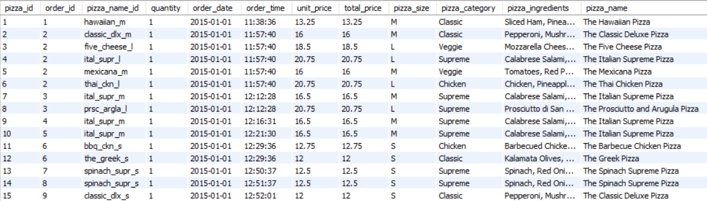
SQL ANALYSIS (QUERIES)
This dataset contain detailed information about pizza orders, including specifics about
the pizza variants, quantities, pricing, dates, times, and categorization details.
The final result is displayed below after the raw data is fed into SQL and certain columns, such as order_date and order_time, have had their data types altered.

Slide 8
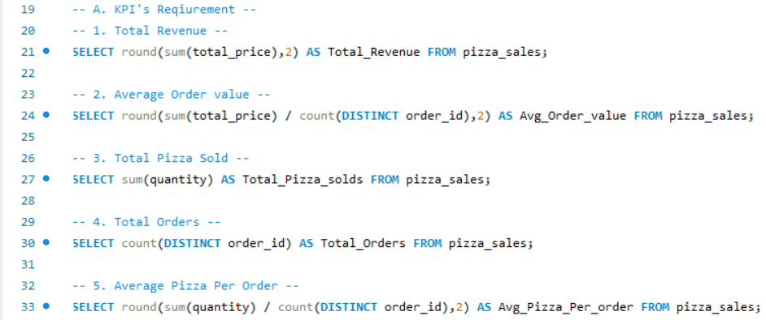
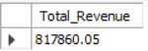
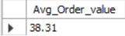
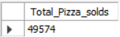
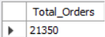
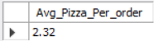
IMPORTANT KPI’S CALCULATIONS
Total Revenue: The sum of the total price of all pizza orders.
Average Order value: The average amount spent per order, calculated by dividing the total revenue by the total number of orders.
Total Pizzas Sold: The Sum Of the quantities of all pizza sold.
Total Orders: The total number of orders placed.
Average Pizzas Per Order: The average number of pizzas sold per order, calculated by dividing the total number of pizzas sold by the total number of orders.
OUTPUTS:-

Slide 9
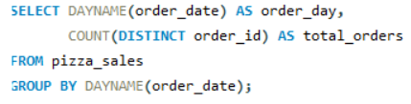
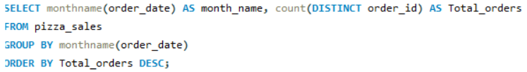
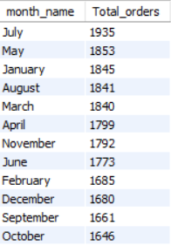
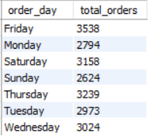
TRENDS OVERVIEW
Daily Trends for Total Orders: The number below displays the daily trend over a specific time period. This will help us to identify any pattern in order volumes on a daily basis.
Monthly Trends for Total Orders: The number below displays monthly trend over a specific time period . This will help us to identify and pattern in order volumes on a monthly basis.
OUTPUTS:-
Daily Trends
Monthly Trends

Slide 10
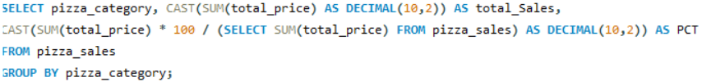
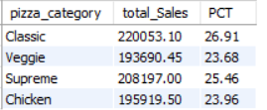
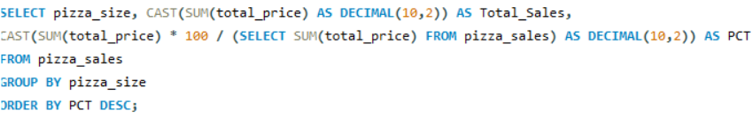
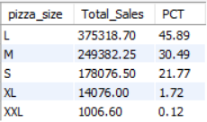
PERCENTAGE SALES CALCULATIONS
Percentage of Sales by Pizza Category: The percentage in output shows the distribution of sales across different pizza category. This will provide insights into the popularity of various pizza categories and their contribution to overall sales.
Percentage of Sales by Pizza Size: The percentage in output shows the distribution of sales across different pizza Size. This will provide insights into the popularity of various pizza size and their contribution to overall sales.
OUTPUTS:-

Slide 11
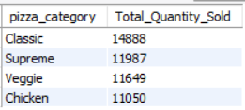
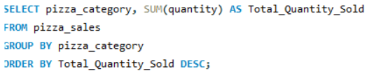
TOTAL SALES BY PIZZA CATEGORY
Total Pizza Sold by Pizza Category: It represents the total number of pizzas sold for each pizza category. This will allow us to compare the sales performance of different pizza categories.
OUTPUT:-

Slide 12
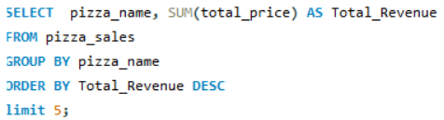
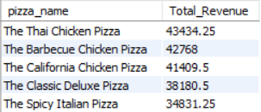
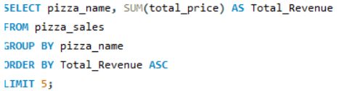
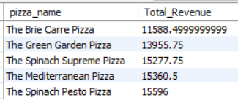
BEST/WORST SELLERS BY TOTAL REVENUE
Top 5 Best Sellers by Revenue: This SQL code shows the top 5 best pizzas sold based on total Revenue. This numbers will help us identify the most popular pizza options.
Bottom 5 Best Sellers by Revenue: This SQL code shows the bottom 5 pizzas sold based on total Revenue. This numbers will help us to identify the not so popular pizza options.
OUTPUTS:-

Slide 13
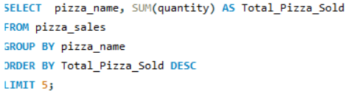
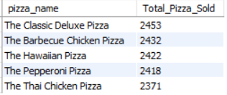
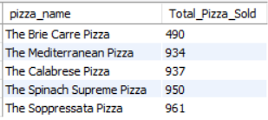
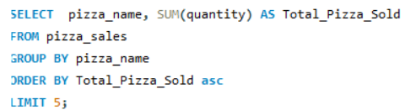
BEST/WORST SELLERS BY TOTAL QUANTITY
Top 5 Best Sellers by Quantity: This SQL code shows the top 5 best pizzas sold based on total quantity. This numbers will help us identify the most popular pizza options.
Bottom 5 Best Sellers by Quantity: This SQL code shows the bottom 5 pizzas sold based on total quantity. This numbers will help us to identify the not so popular pizza options.
OUTPUTS:-

Slide 14
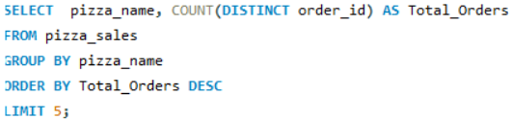
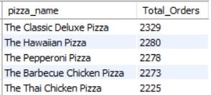
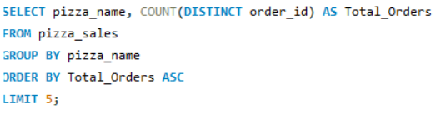
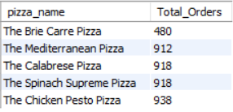
BEST/WORST SELLERS BY TOTAL ORDERS
Top 5 Best Sellers by Total Orders: This SQL code shows the top 5 best pizzas sold based on total Orders. This numbers will help us identify the most popular pizza options.
Bottom 5 Best Sellers by Total Orders: This SQL code shows the bottom 5 pizzas sold based on total Orders. This numbers will help us to identify the not so popular pizza options.
OUTPUTS:-

Slide 15
SQL SERVER
CONNECT
POWER BI
Connecting SQL Server to Power Bi is an essential step in leveraging the powerful data visualization capabilities of Power BI to analyze Pizza sales data stored in SQL server. This connection allows for the seamless integration of robust data management with interactive reporting, provide valuable insights into Sales trend, pizzas performance and customer’s pizza preferences.
Benefits:
Real-time Data Analysis: With DirectQuery, Power BI can query data directly from SQL Server, providing up-to- date insights without the need for frequent data imports.
Comprehensive Reporting: By combining queries and views from SQL Server, Power BI enables the creation of detailed and comprehensive reports that cover various aspects of pizza sales.
Interactive Dashboards: Power BI’s interactive features allow users to filter data dynamically, drill down into details, and uncover hidden trends in pizza sales data.
Improved Decision-Making: The insights derived from Power BI reports can inform strategic decisions such as inventory management, marketing campaigns, and customer engagement strategies.
We can construct new measures and columns using the DAX function after connecting SQL to Power Bi, and we can also make interactive reports after that.In summary, the integration of SQL Server with Power BI for pizza sales analysis empowers businesses to transform raw sales data into actionable insights, driving better decision-making and enhancing overall business performance

Slide 16


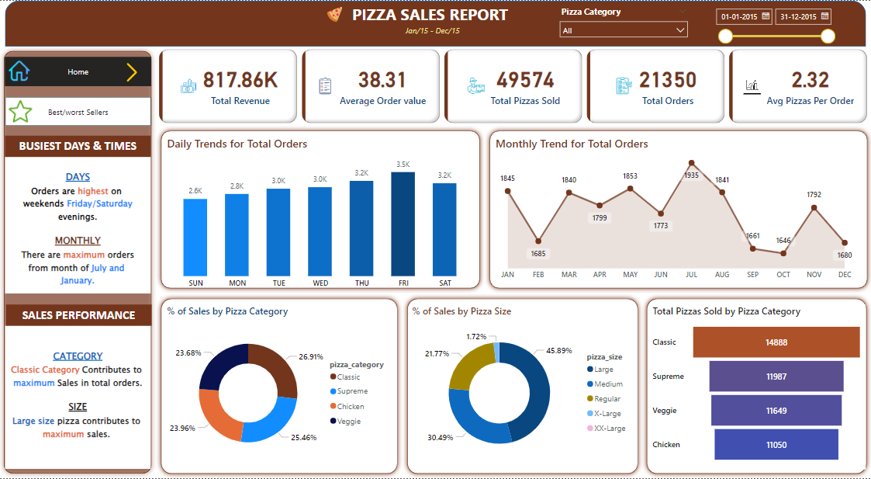
REPORT – 1: Sales Analysis

Slide 17
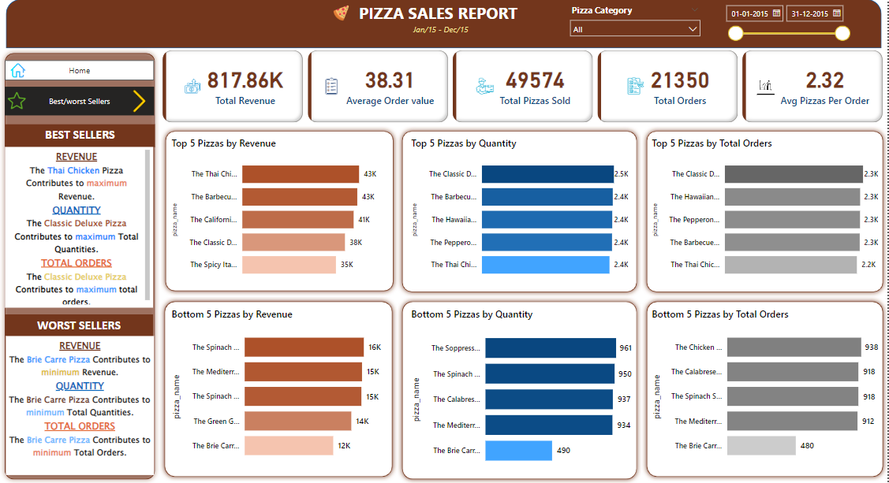
REPORT – 2: Best/worst Sellers

Slide 18
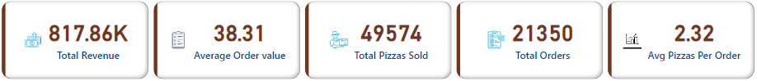
REPORT 1- Sales Analysis
KEY INSIGHTS
1. KPI’S REQUIREMENT:
KEY PERFORMANCE INDICATOR:-
Total Revenue: The sum of the total price of all pizza orders is 817.86K.
Average Order value: The average amount spent per order is 38.31.
Total Pizzas Sold: The Sum Of the quantities of all pizza sold is 49,574.
Total Orders: The total number of orders placed is 21,350.
Average Pizzas Per Order: The average number of pizzas sold per order is 2.32.

Slide 19
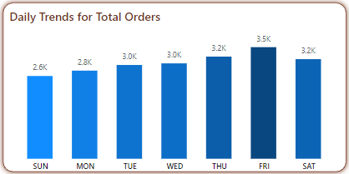
2. STACKED COLUMN CHART:
Daily Trends for Total Orders
The purpose of this stacked column chart is to display daily trends by total orders. It is evident from the chart that Thursday, with 3.5k orders, is the highest day of the week, followed by Friday & Saturday with 3.2k orders, and Sunday & Monday, with 2.6k and 2.8k orders are the lowest.

Slide 20
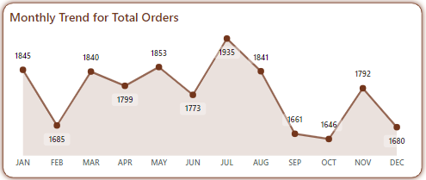
3. AREA CHART:
Monthly Trend
for Total Orders
This Stacked Column Chart was created to display the trends for
each month broken down by Total Orders. The graph makes it evident that the top three months of the year are July (1,935 orders), January (1845 orders) & May (1853 orders). September & October saw the fewest orders placed during the month, at 1,661 & 1,646 respectively. This indicates that the majority of pizza orders will be placed in July.

Slide 21
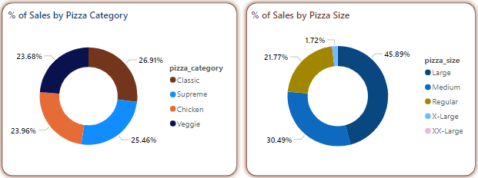
4 & 5 PIE CHART: Percentage Sales by
Pizza Category & Size
To show the distribution of sales across various pizza categories and sizes, pie charts were constructed. The first graphic makes it quite evident how sales are broken down by type of pizza; the most popular varieties are classic (26.91%) & supreme(25.46%), followed chicken & vegetable.
In the second graphic, it is evident that sales are broken down by pizza size, with large(45.89%) & medium(30.49%) pizzas having the highest sales, followed by normal and x-large pizzas.

Slide 22
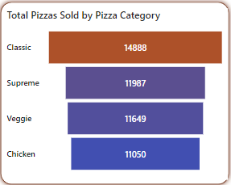
6. FUNNEL: Total Pizzas Sold by Pizza Category
Analyzing the total number of pizzas sold by category provides valuable insights into customer preferences and sales performance across different pizza types.
The total number of pizzas sold by category is shown in this figure; the most popular categories are Classic with (14, 888 sold) & Supreme with (11,987 sold).

Slide 23
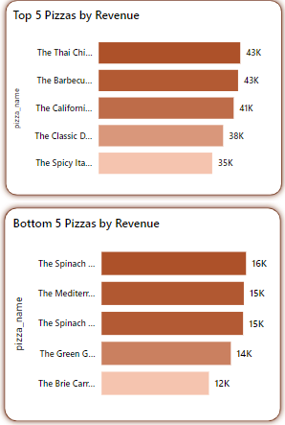
Report 2 - Best/Worst sellers
1 & 2 STACKED BAR CHART: Top & Bottom 5 Pizzas
By Revenue
The top five pizzas in terms of revenue are displayed in the first visual expression. With 43K, Thai & Barbecue chicken pizzas bring in the most money. California chicken (41k), classic deluxe (38k), & spicy Italian (35k) pizzas are next in line.
In the second visual expression, the lowest five pizzas in terms of revenue are shown. The Spinach Pesto makes the least money, with 16k. The next in line, in minimum revenue, are the Mediterranean (15k), Spinach Supreme (15k), Green Garden (14k), & Brie Carrie pizzas (12k).

Slide 24
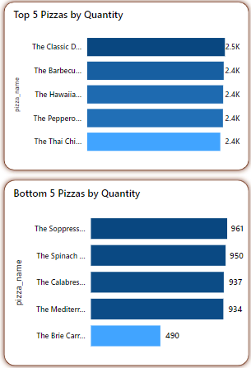
3 & 4 STACKED BAR CHART: Top & Bottom 5 Pizzas by
Quantity
The first visual representation shows the top five pizzas in terms of Quantity. The most popular pizza, total pizzas sold for 2.5K, is the classic deluxe pizza. Next in line are the Hawaiian, Pepperoni, and Thai chicken pizzas, & barbecue chicken each with 2.4k pizzas sold.
In the second visual expression, the bottom five pizzas in terms of Quantity are shown. The Brie Carrie makes the least sold pizza, with 490. The next in line, in minimum pizzas sold, are the Spinach Supreme (950), Calabrese (937),Mediterranean (934), & Soppressata (961) pizzas.

Slide 25
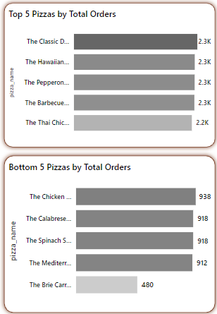
5 & 6 STACKED BAR CHART: Top & Bottom 5 Pizzas by
Total Orders
In the first visual expression, the top five pizzas in terms of total orders are shown. The pizzas with the most orders are the classic deluxe , Hawaiian, pepperoni, & barbecue chicken, each with 2.3K. With 2.2k orders, Thai pizza is the second best ordered type of pizza.
In the second visual expression, the lowest five pizzas in terms of total orders are shown. The Brie Carrie pizza makes the least orders, with 480. The next in line, in minimum orders, are the Mediterranean (912) ,Spinach Supreme & Calabrese pizza with 918 . Then at last The chicken Pesto pizza with 938 orders.

Slide 26
REFERENCES
Data Source:
Next Millionaire. "Pizza Sales Dataset.” Kaggle, 2023. Available at: Kaggle Pizza Sales Dataset
Data Access Method:
The dataset was directly downloaded using the Kaggle with the following link:
www.kaggle.com/datasets/nextmillionaire/pizza-sales-dataset/data
The dataset can also be accessed and downloaded using the Kaggle API with the following command:
kaggle datasets download -d nextmillionaire/pizza-sales-dataset
This commands allows for easy programmatic access and integration of the dataset into data analysis workflows.

Slide 27
THANK YOU

